Slide 1


Insurance Management System (08-08-2022)
Mohan Dongara
Bhargav Reddy
Akash Pawade

Slide 2

PROBLEM STATEMENT
Build a web system that can manage insurance payments and allow users to sign up for a variety of insurance plans falling under two categories, health and home insurance.
The health insurance part of the website should be able to contain a variety of insurance plans, each of which have a structure for premium payment, a list of covered illnesses and a list of covered hospitals and the Home Insurance with city and areas covered .

Slide 3
Introduction
Our system manages two types of Insurance Policies (Home and Health Insurance)
In Home Insurance we have list of Home insurance policies
In Health insurance we have list of Health insurance policies

Slide 4
Approach
First we learnt how Insurance Policies work and then we framed an idea how the flow of our system should work
Then we gathered the information required for our Database , Backend and Frontend
Then we decided what are the tables required in our database and created
We used springboot to bring the data from database in the form of JSON
Finally we started working with front end pages with angular and integrated all the things and developed a working Digital Insurance Management System

Slide 5
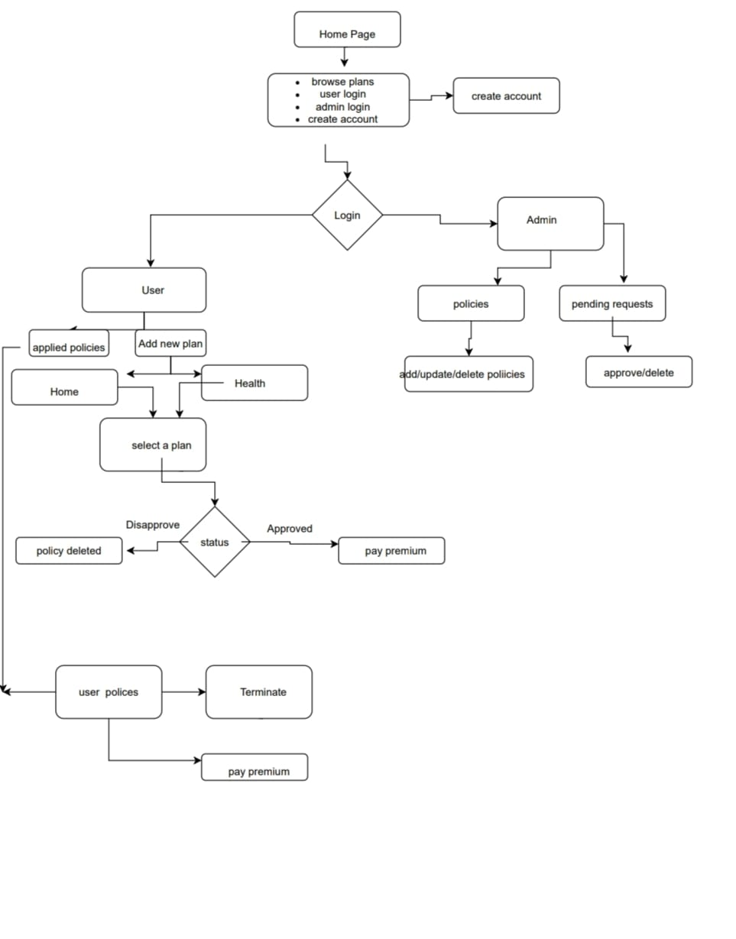

Slide 8
CHALLENGES
When user applies for a policy the data should be routing to Admin and when admin accepts the request the same data again re-routing to user again
We have faced so many challenges but this was the main challenge

Slide 9
Learnings
Database design
API
Retrieving the data from database and combining with frontend by applying logics we organized our data according to our requirement

Slide 10
STATISTICS
Database (5 Tables)
SpringBoot (4 Entities , 4 Repositories)
Angular (Classes,Components,Service)

Slide 11
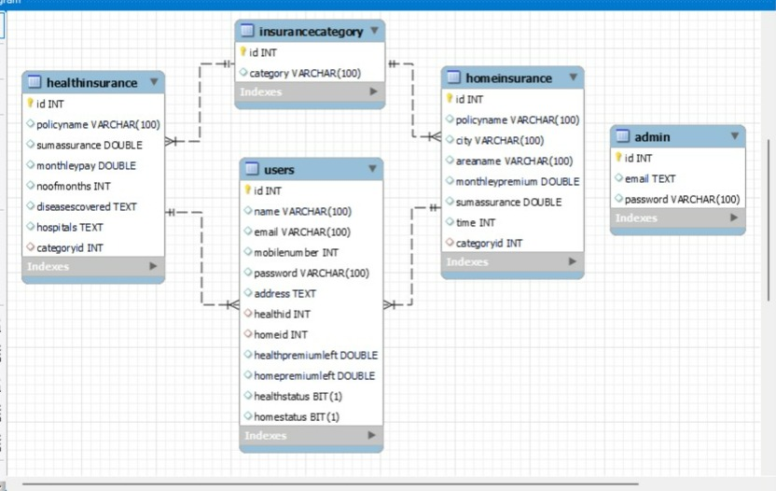
ER Diagram

Slide 12
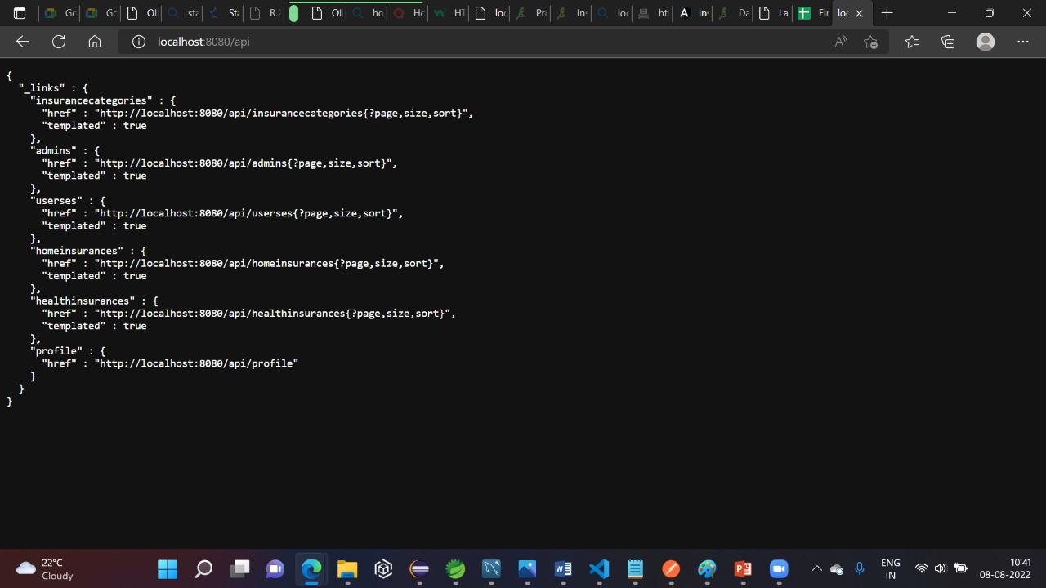

Slide 13


Slide 14
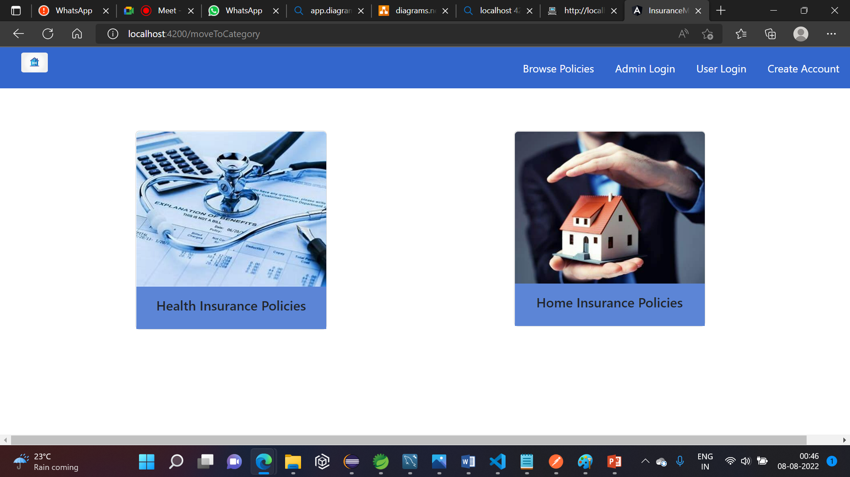
Browse Policies

Slide 15
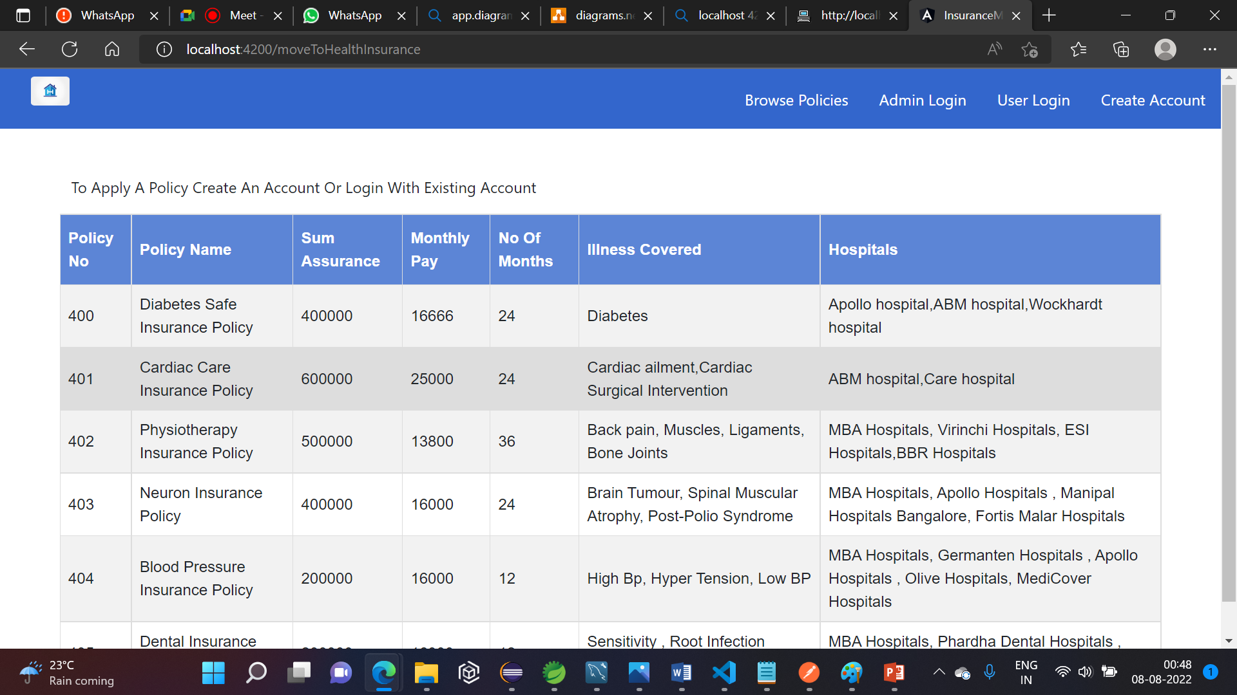
List of Health Policies

Slide 16
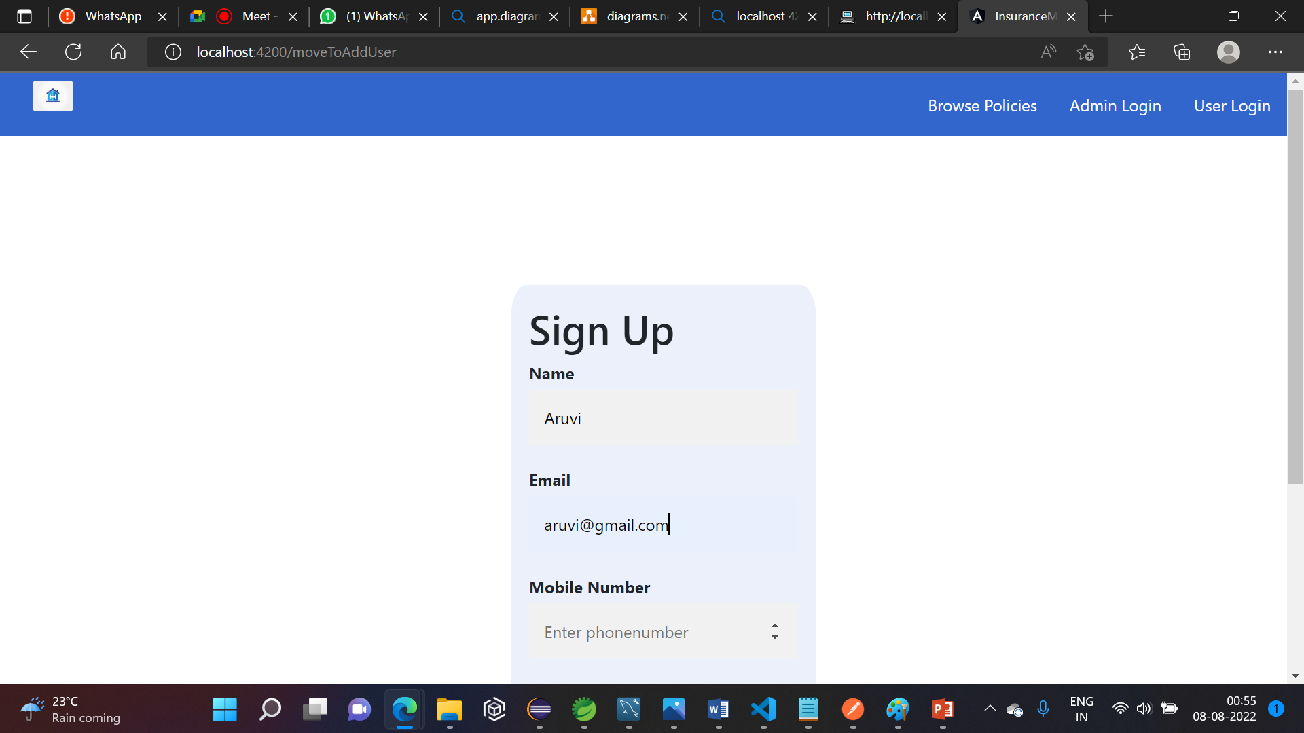
Create Account

Slide 17
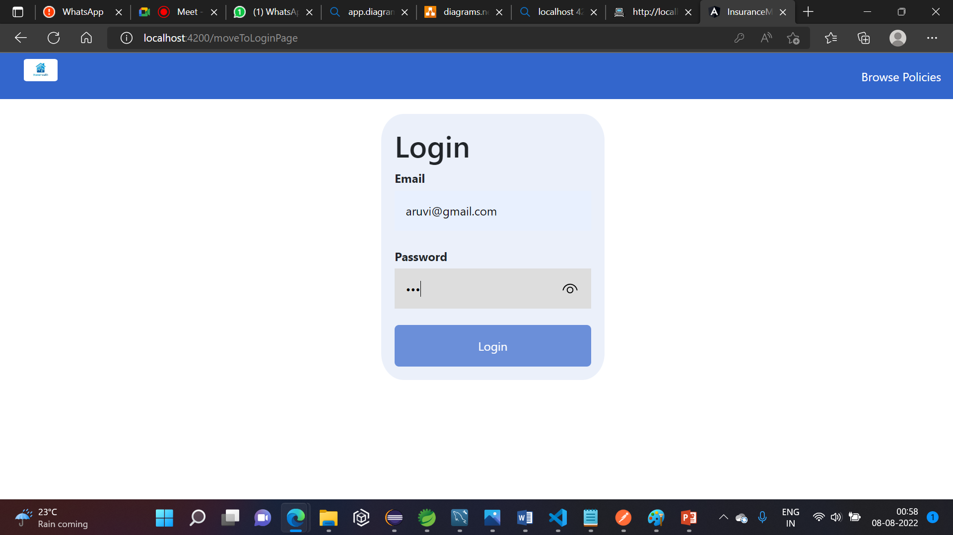
Login Page

Slide 18
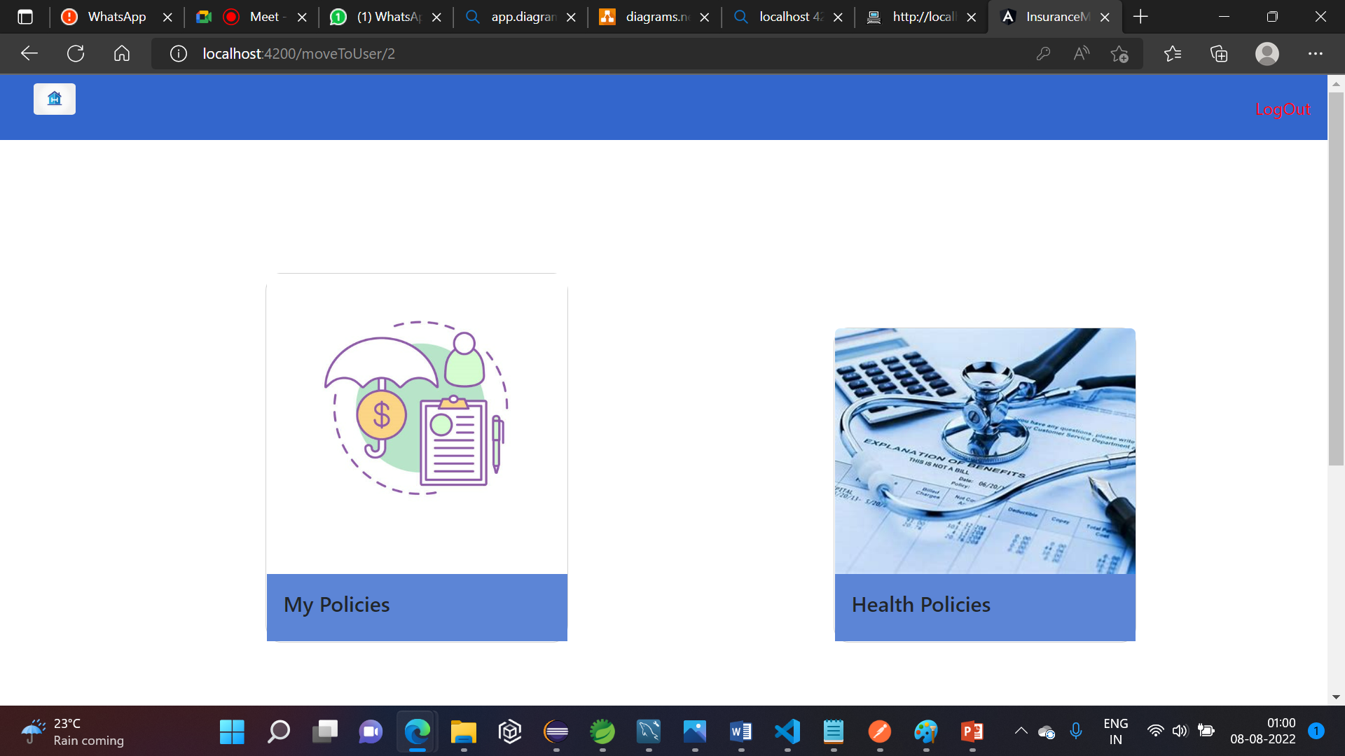
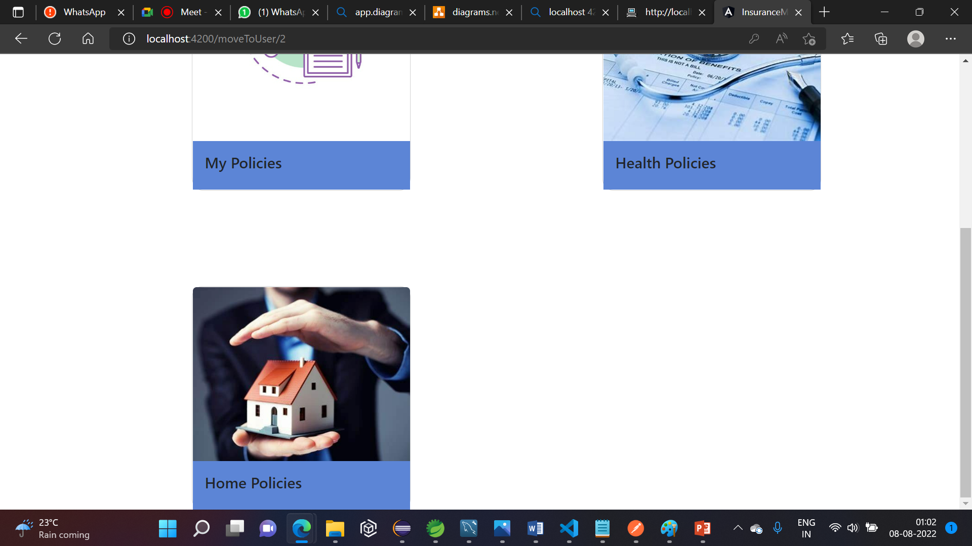
After Logging In

Slide 19
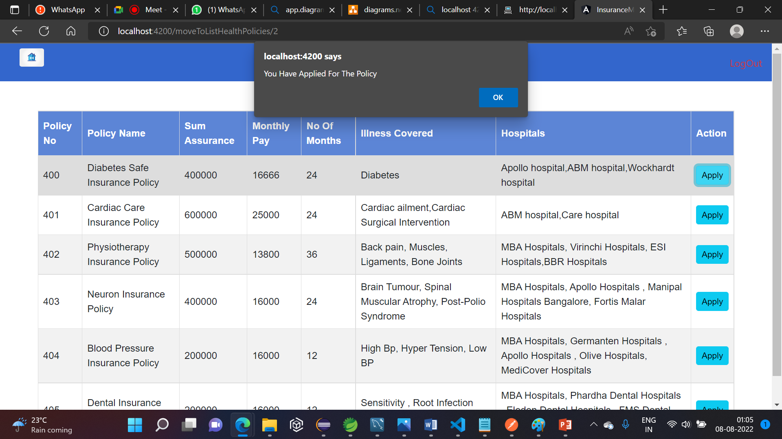
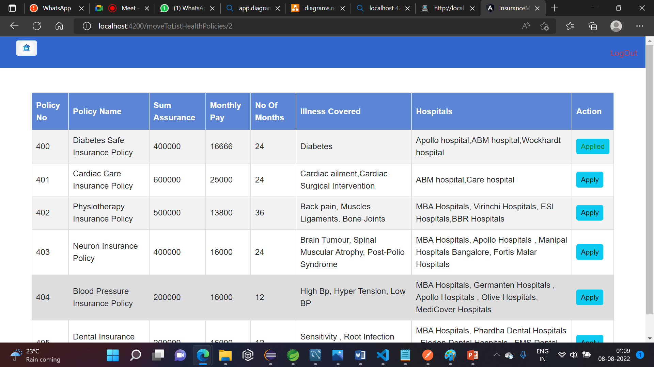
Appling Health policy

Slide 20
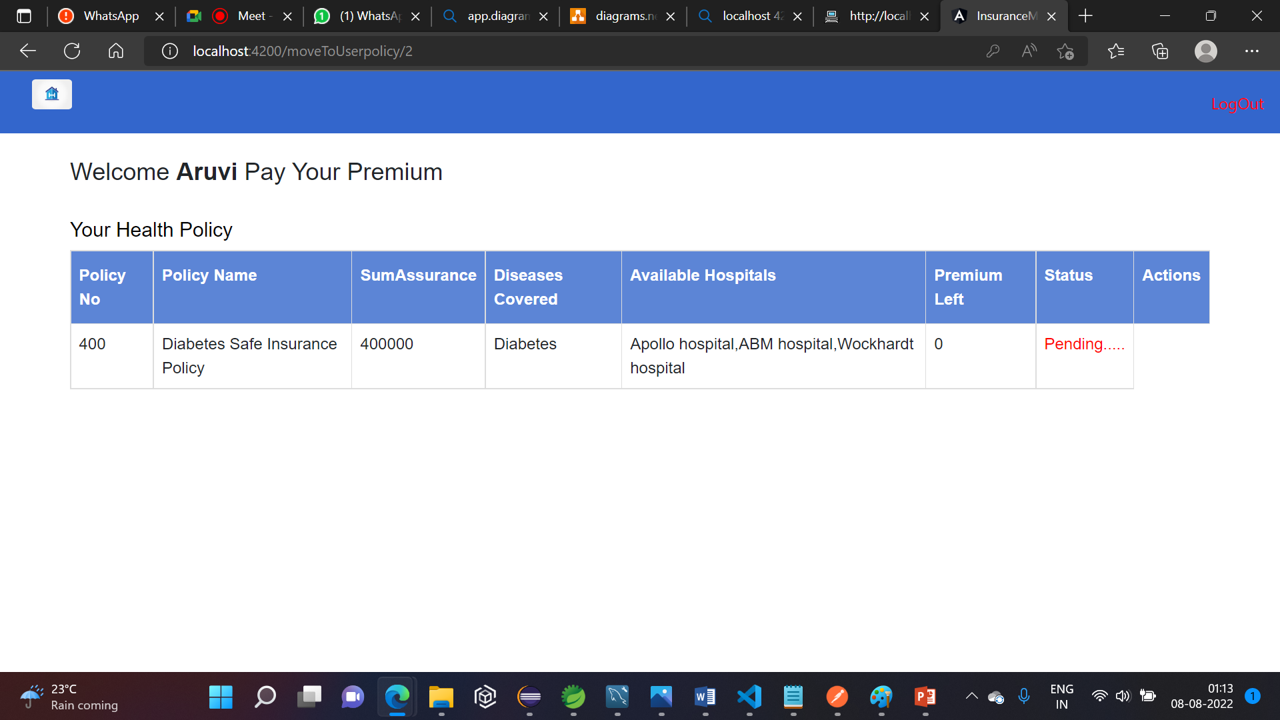
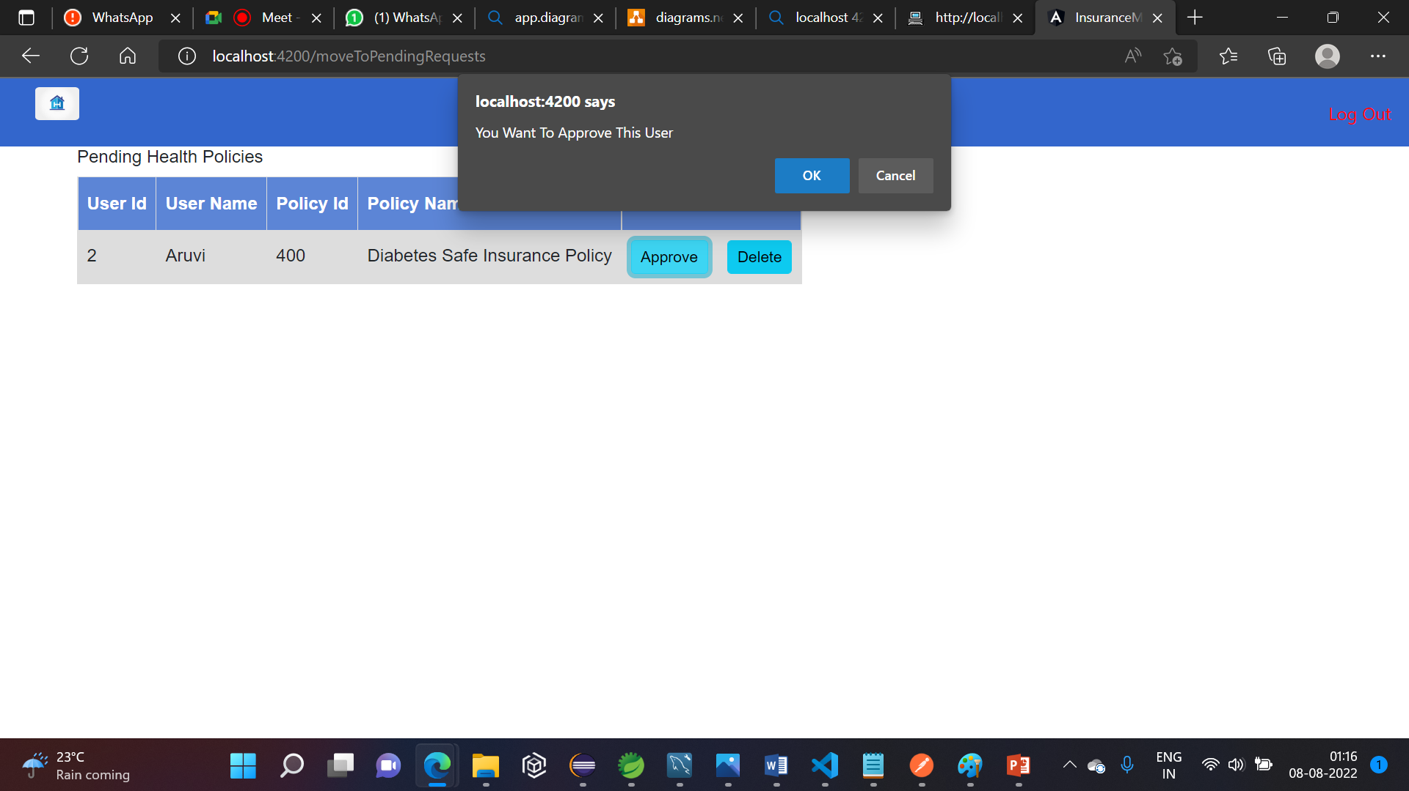
After Appling Policy Goes To Pending Status

Slide 21
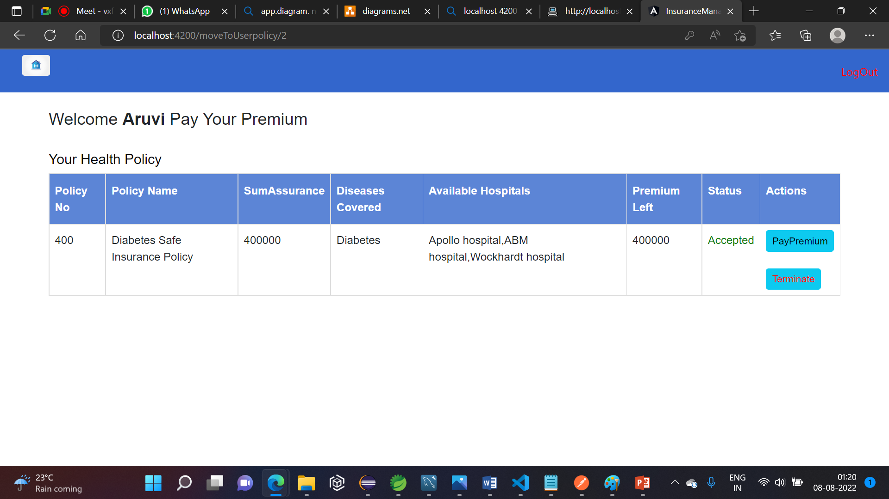
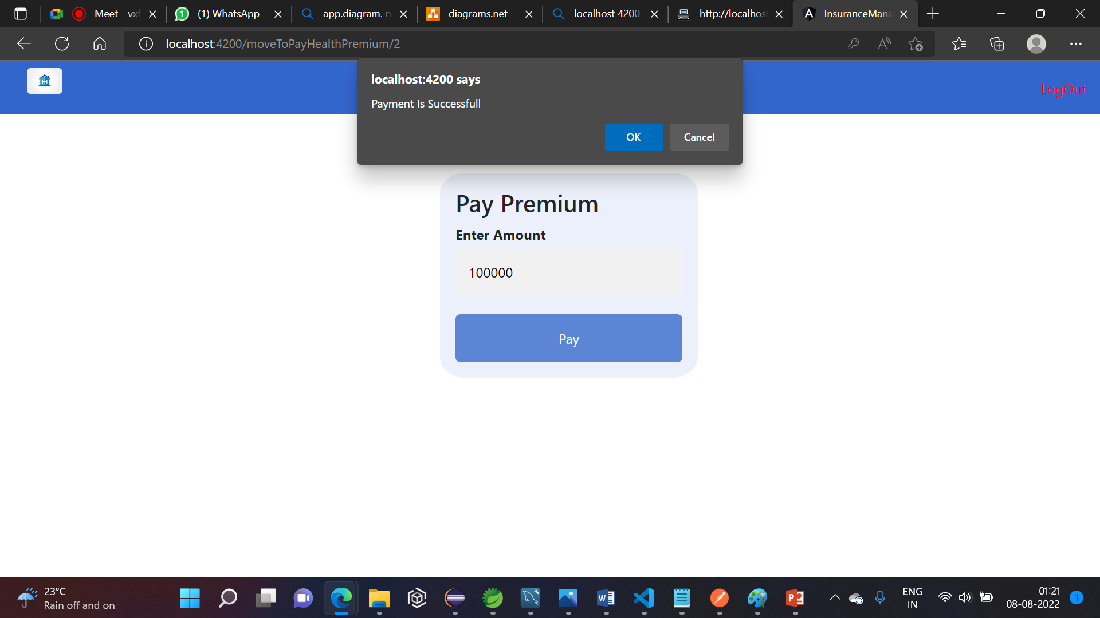
Paying premium after approval

Slide 22

After Payment

Slide 23
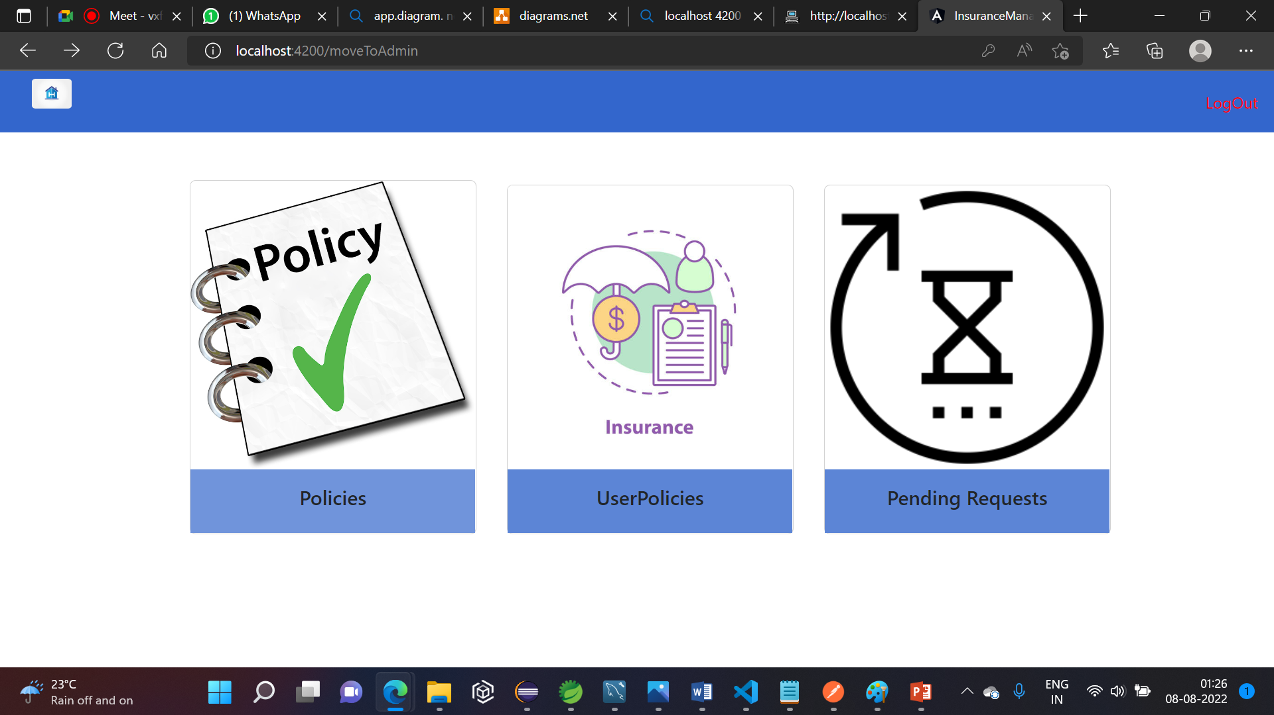
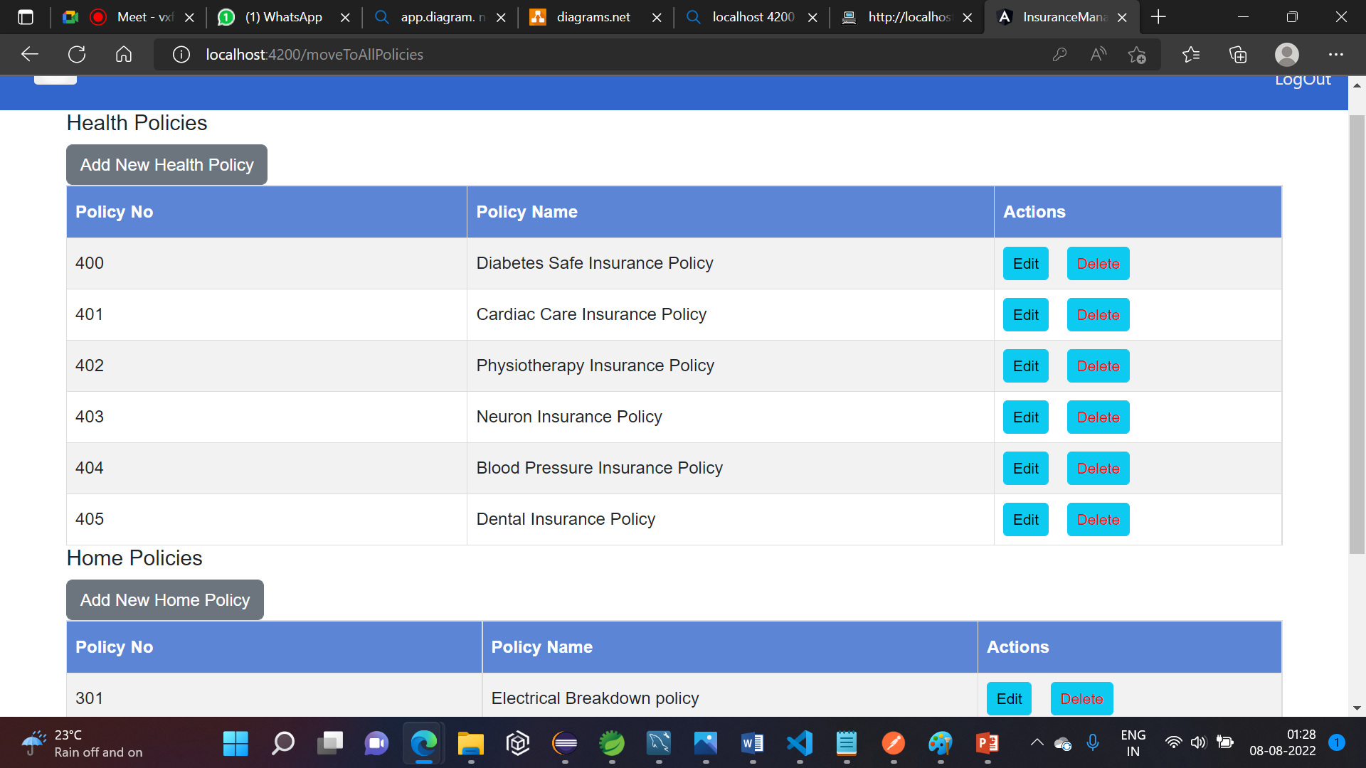
Admin Access

Slide 24
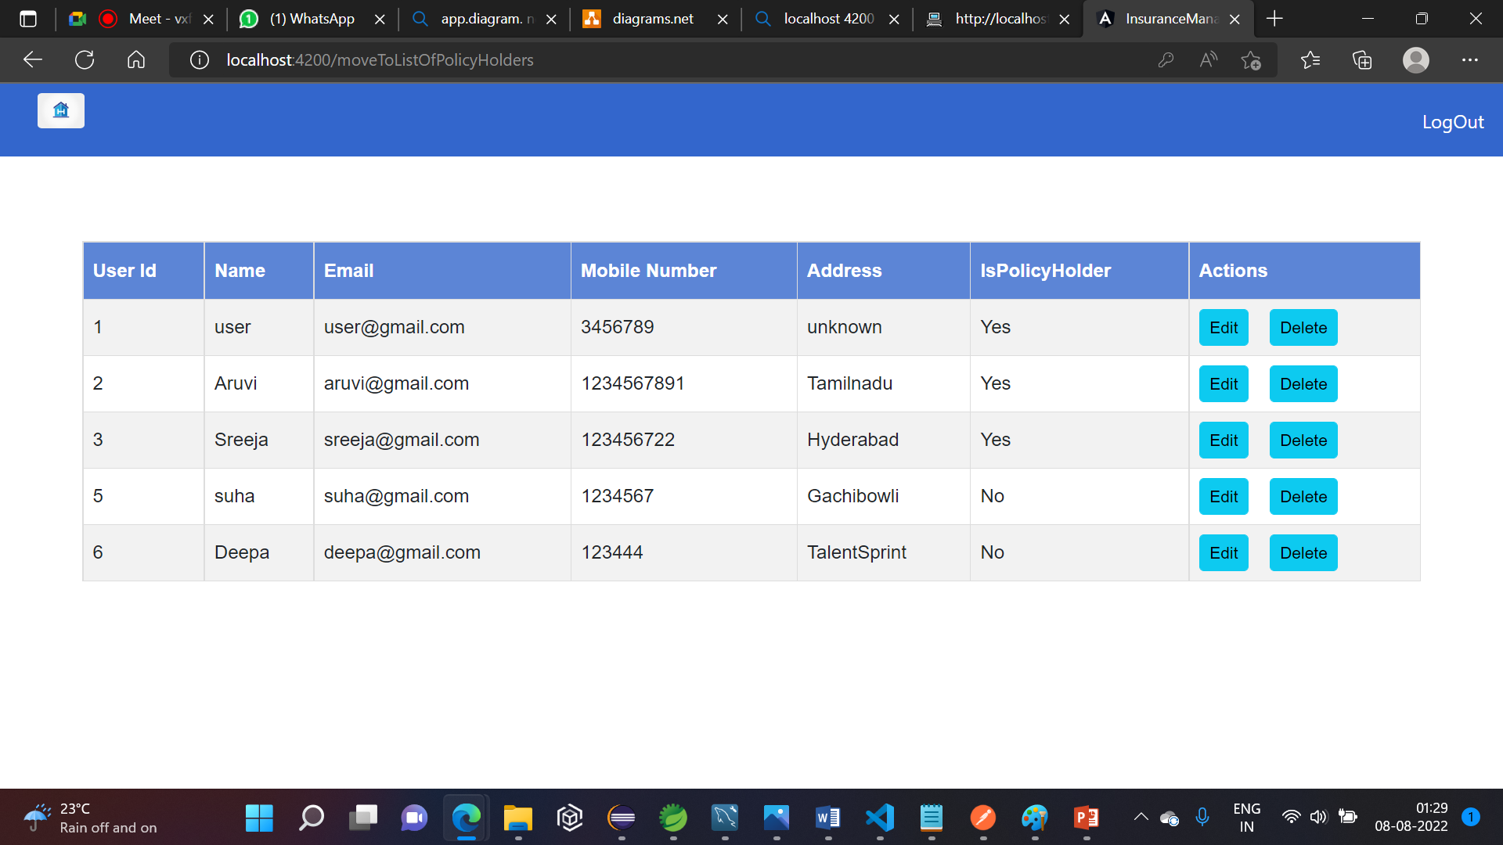

Slide 25
Thank You

